Slide 1
Agent model based on hybrid stochastic automata
Diplomski rad
Patrik Kolarić

Slide 2
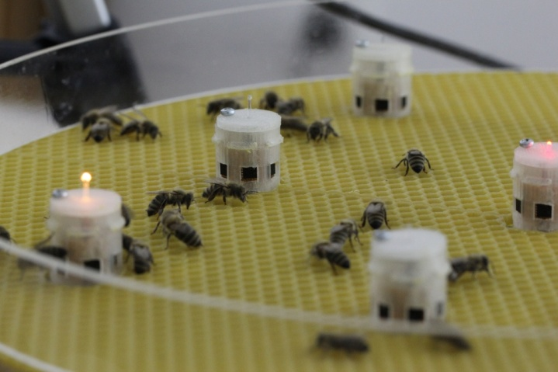
Introduction
Colony of bees
Colective behaviour
Space search
Clustering at optimal point
Temperature, vibrations, pheromones…
Possible to predict?
First, mathematical model!
Problem tackled in thesis:
Is it possible to predict colony aggregation point and moment of it’s formation based on mathematical model of a single agent?

Slide 3
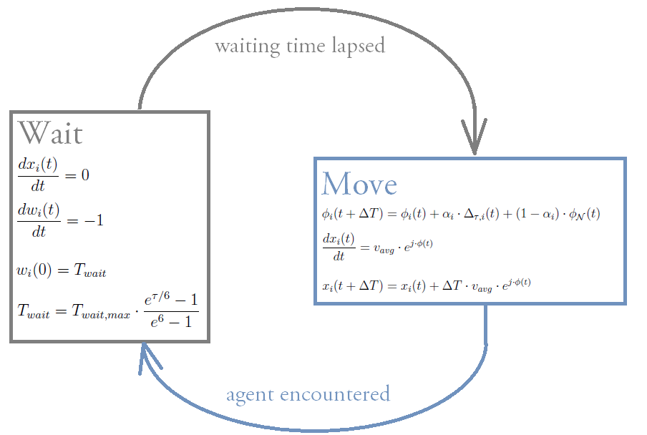
Mathematical model of a single agent

Slide 4
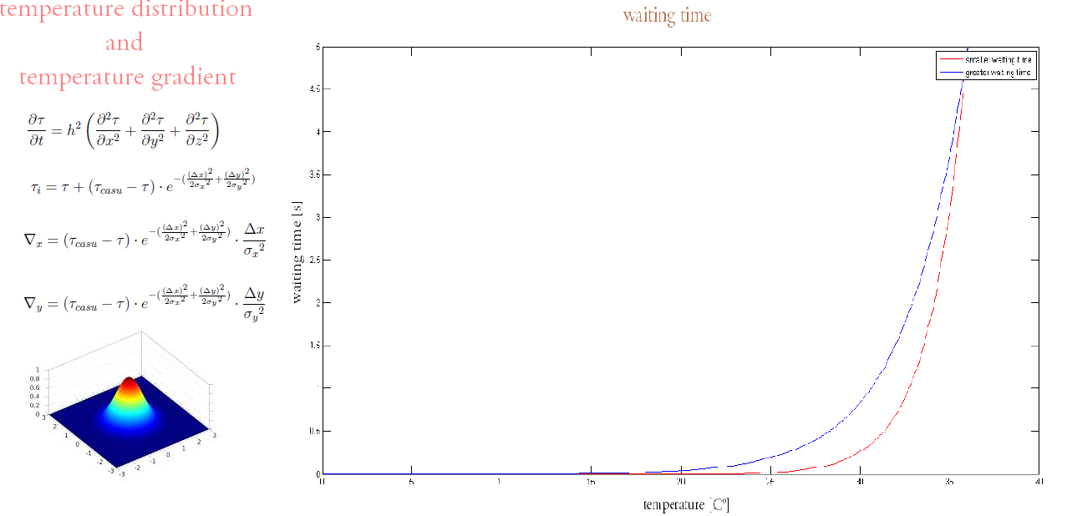

Slide 5
Abstraction of agent’s parameters
Has to take stochastic nature of model into account!
Degree of randomness in movement
Waiting time
Number of agents
Spatial distribution of agents
ABSTRACTION

Slide 6
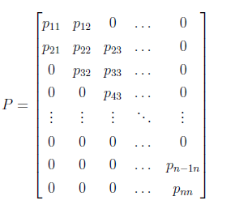
Markov Chains
Abstraction = Markov Chains probabilities calculation
Transition matrix → main mathematical object of abstraction

Slide 7
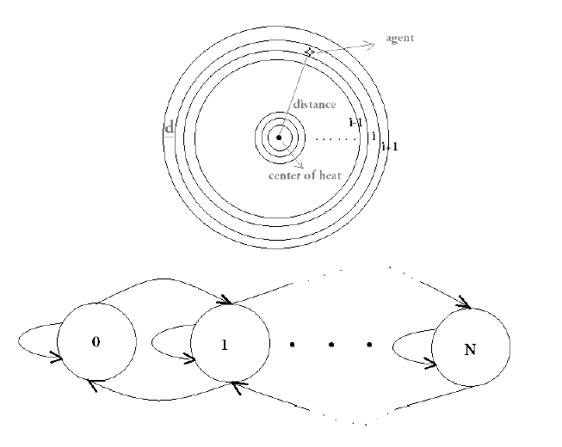

Slide 8
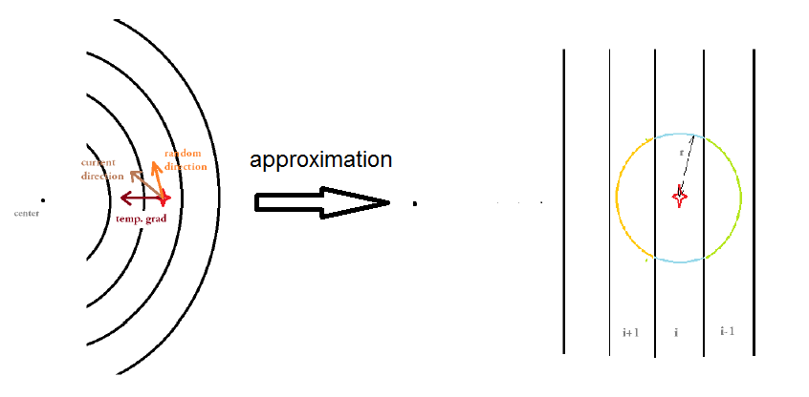

Slide 9
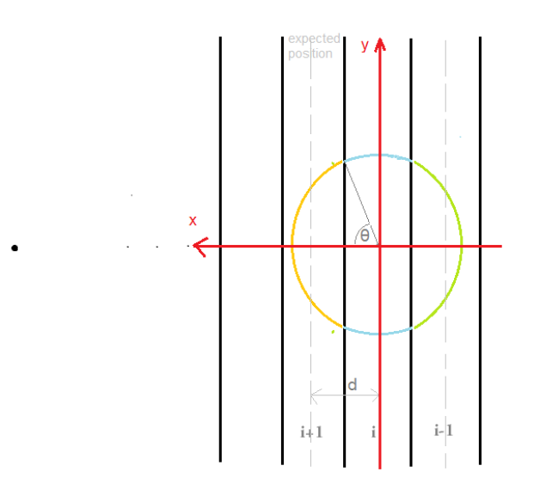
Width of disk
Have to assure Markov Chains transition conditions
Expected position after transition at the center of neighbouring disk

Slide 10
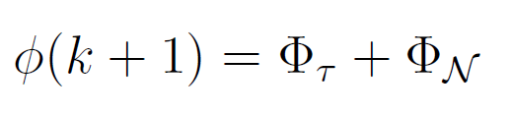
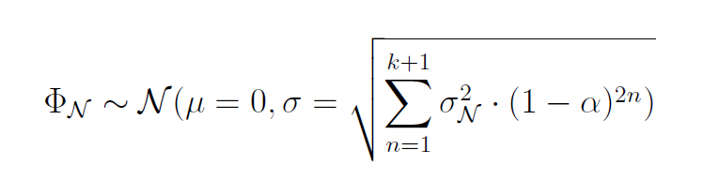
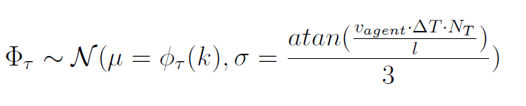
Distribution of direction update

Slide 11
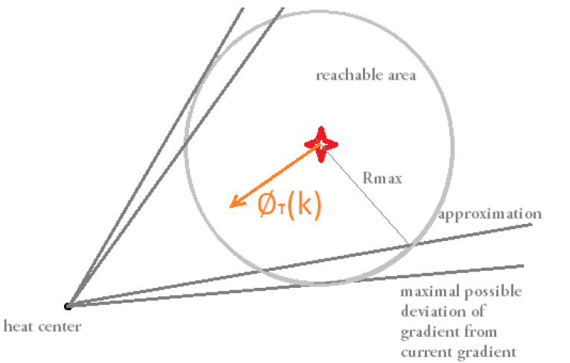

Slide 12
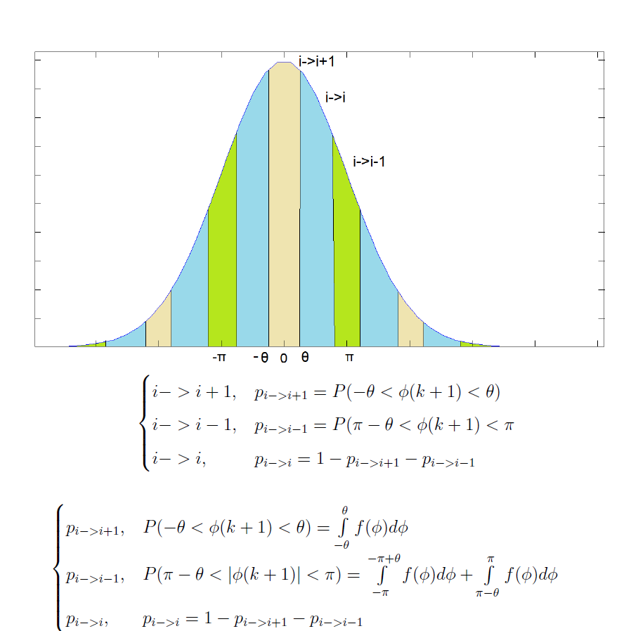

Slide 13
Waiting Time

Slide 14
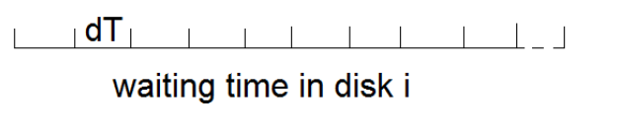
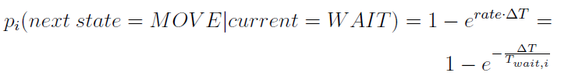

Slide 15
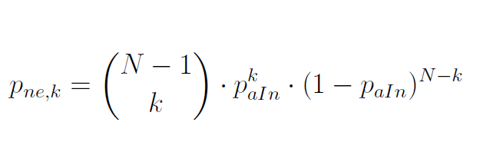
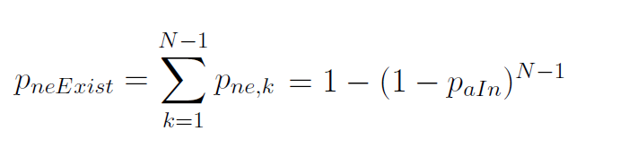

Slide 16
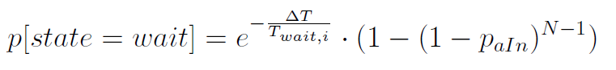

Slide 17
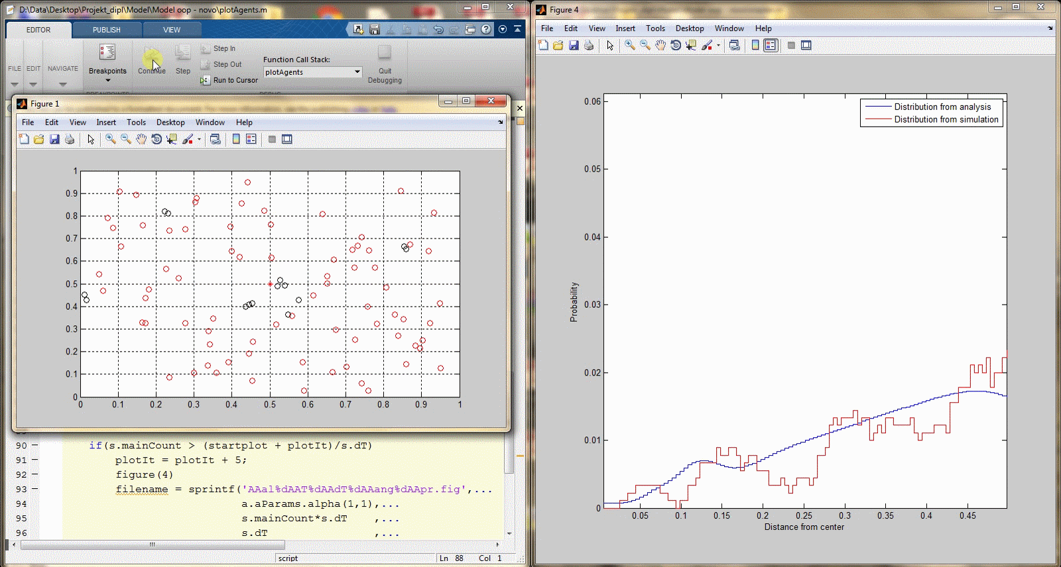

Slide 18
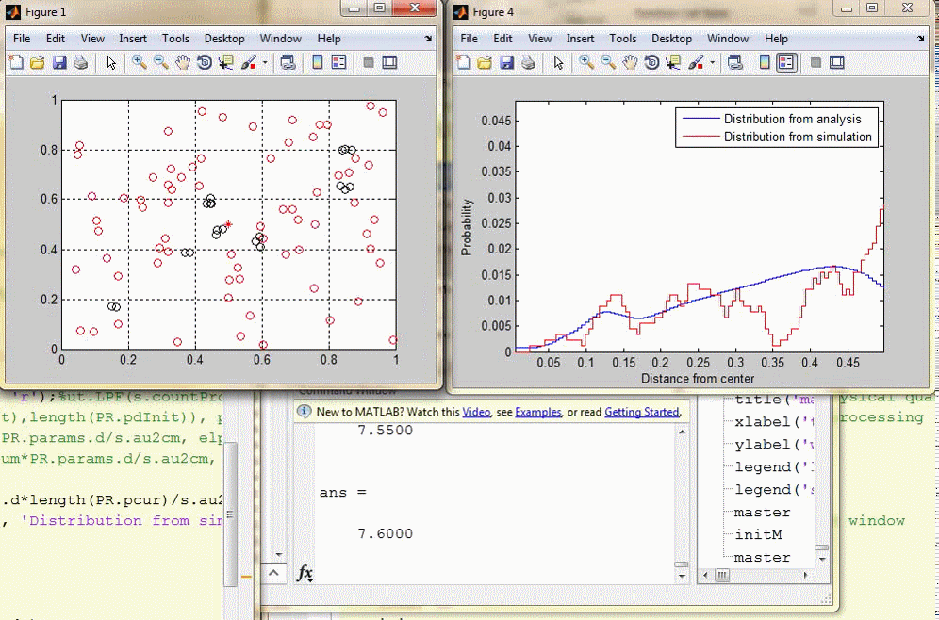

Slide 19
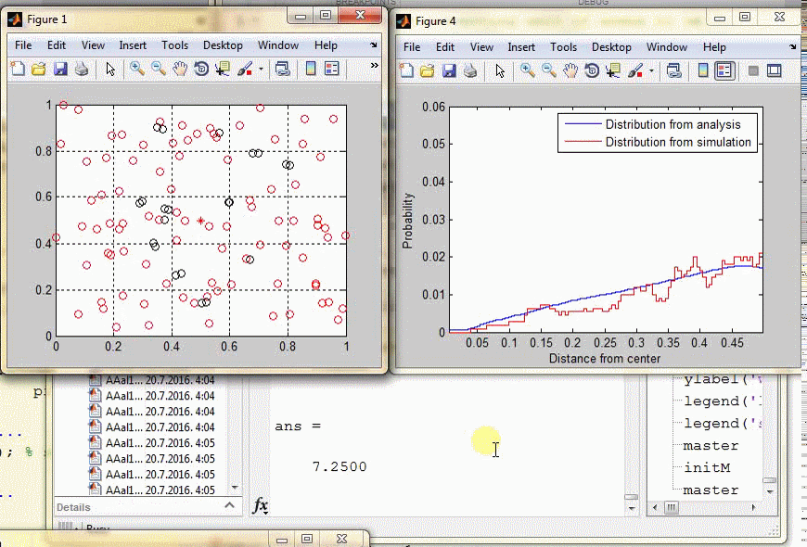

Slide 20
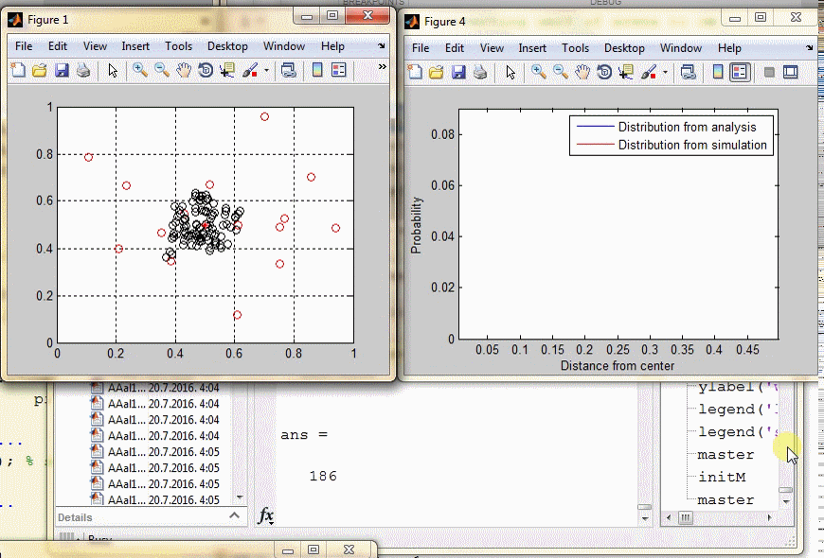

Slide 21
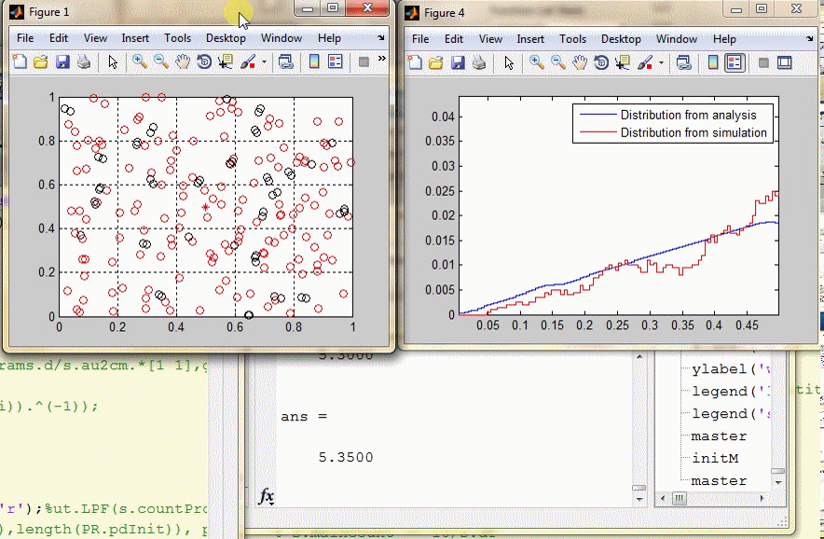

Slide 22
